Slide 1


AI Powered Bot
Mentor
Kartikeya
This Photo by Unknown Author is licensed under CC BY-SA

Slide 2
Overview
Software Requirements
Introduction to Assistant
Introduction to IBM Cloud
©Kartikeya

Slide 3
Requirements
IBM Cloud
IBM Watson
IBM Discovery
IBM Cloud Function
Jupyter Lab
©Kartikeya

Slide 4
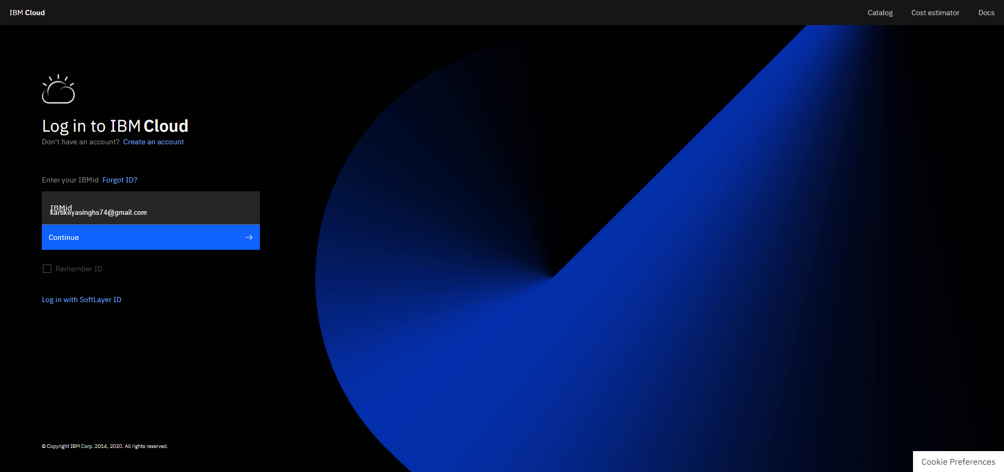
IBM Cloud

Slide 5
IBM Watson

Slide 6
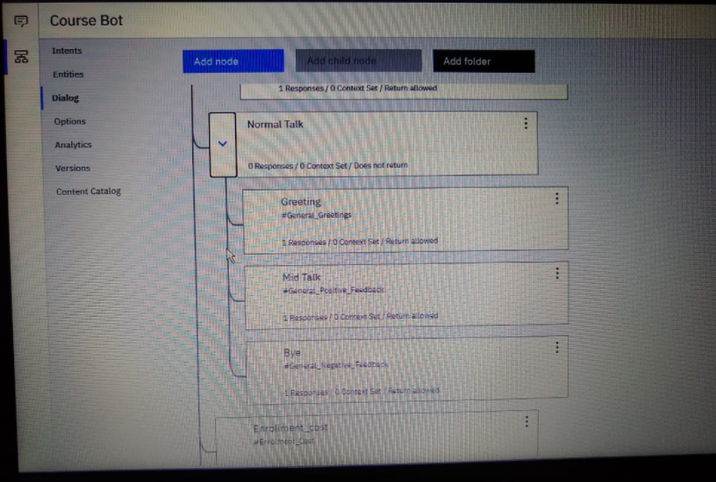
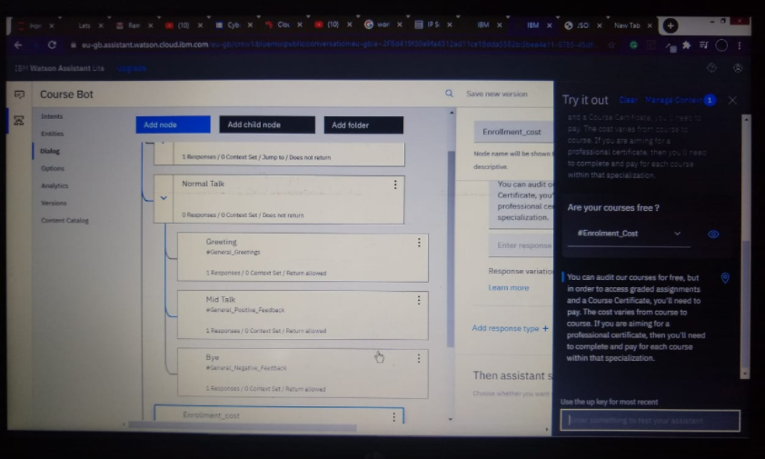

Slide 7
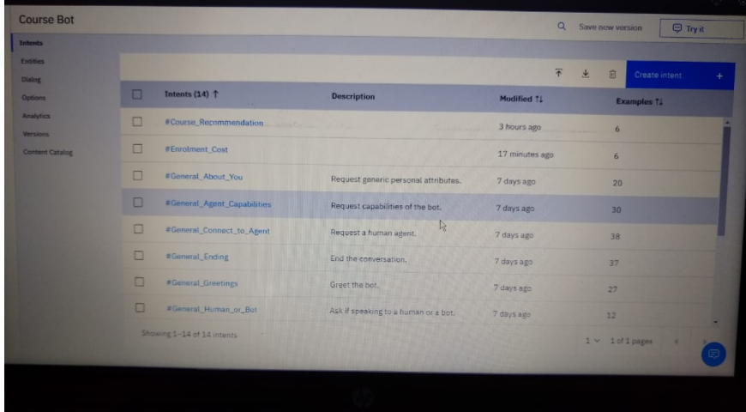

Slide 8
IBM Discovery

Slide 9
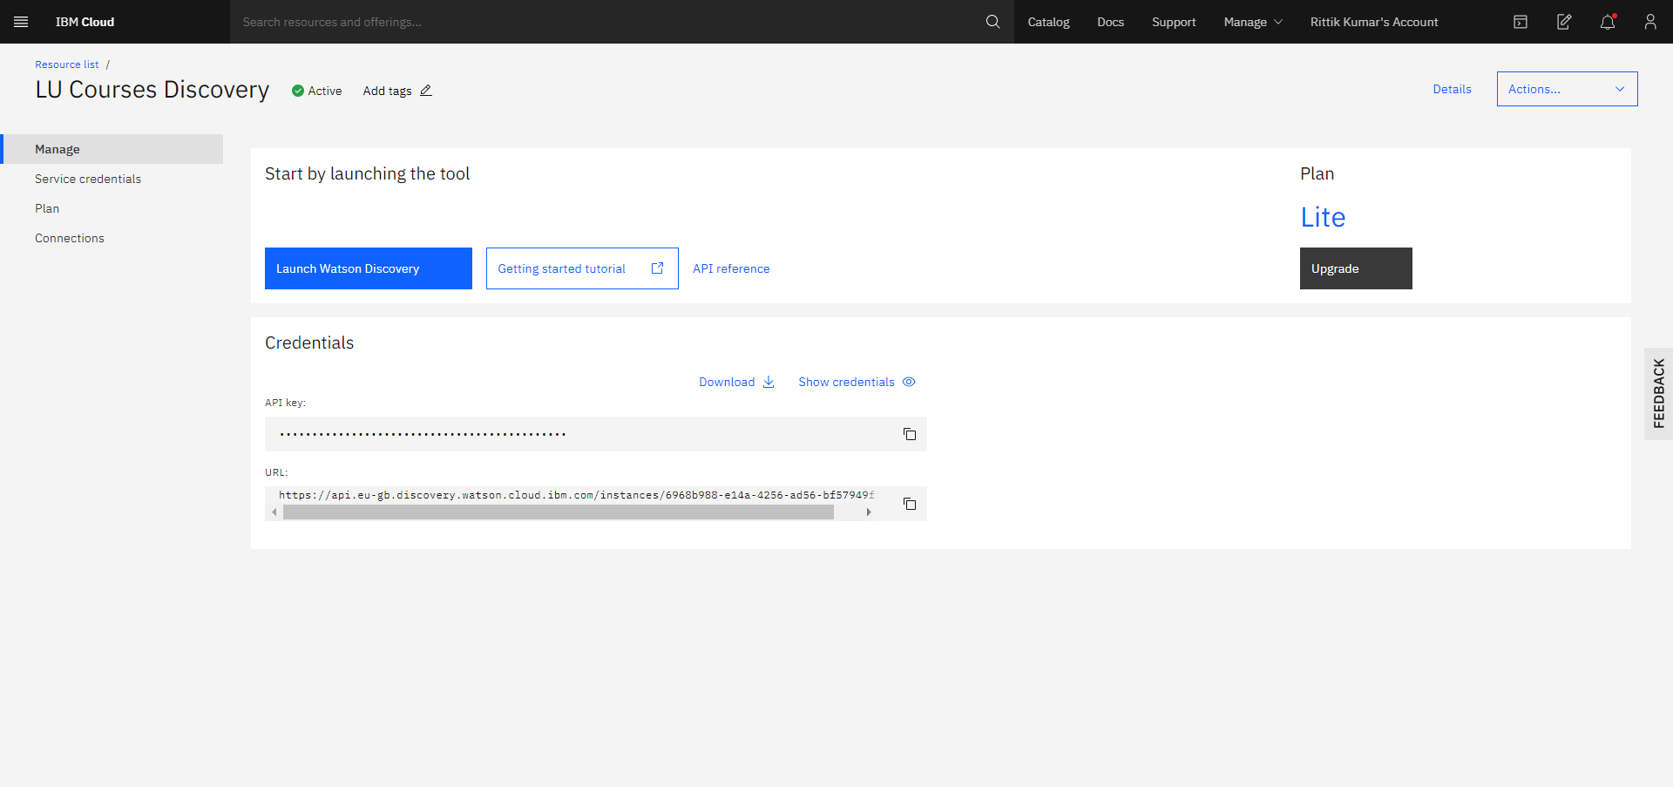
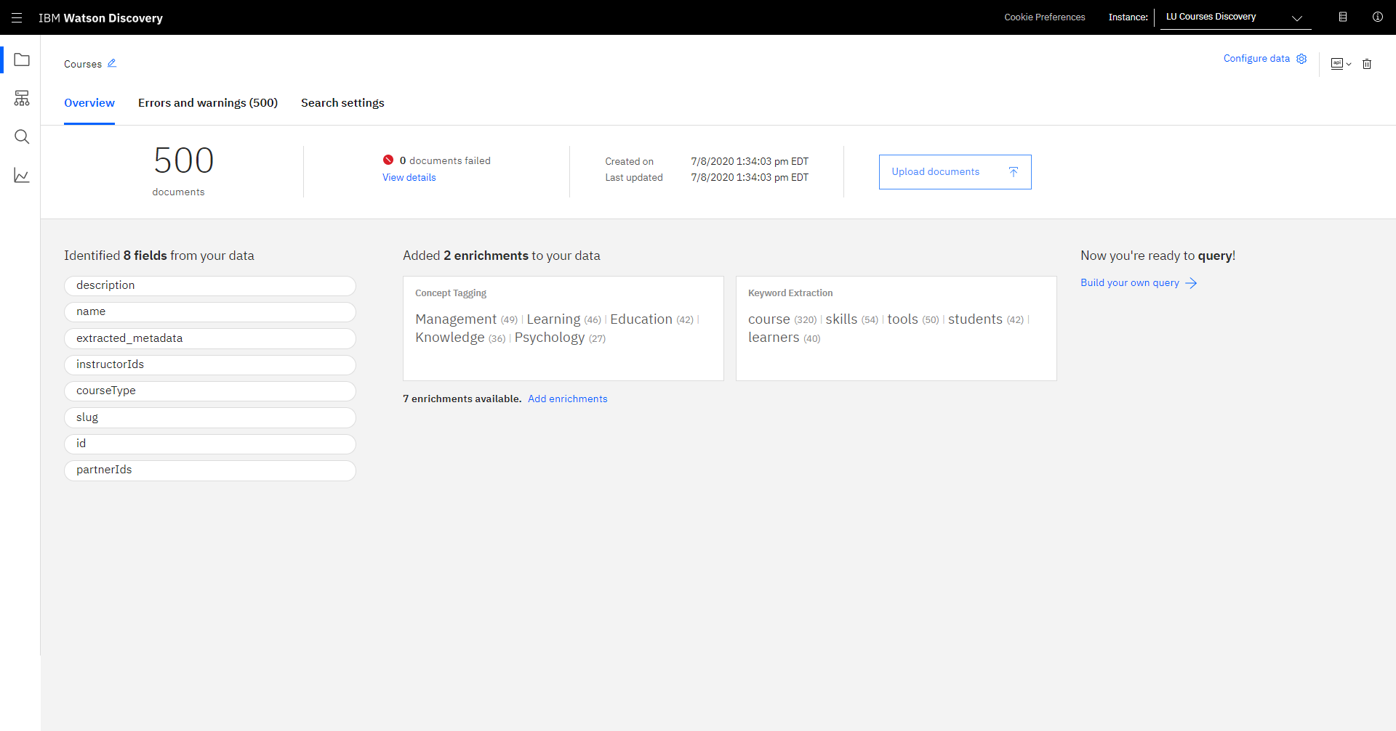

Slide 10
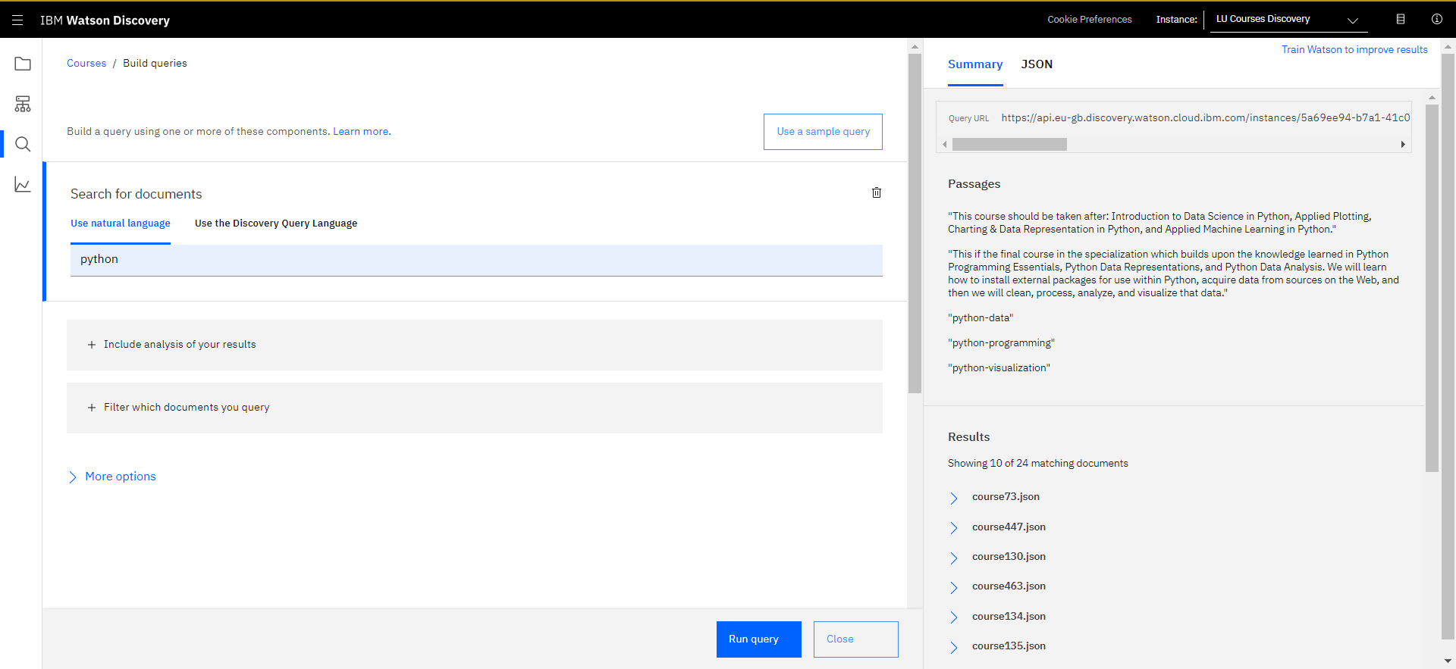

Slide 11
IBM Cloud Function

Slide 12
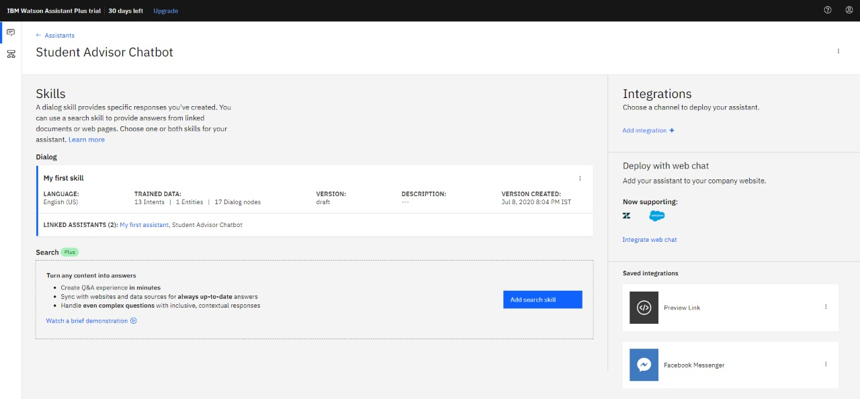
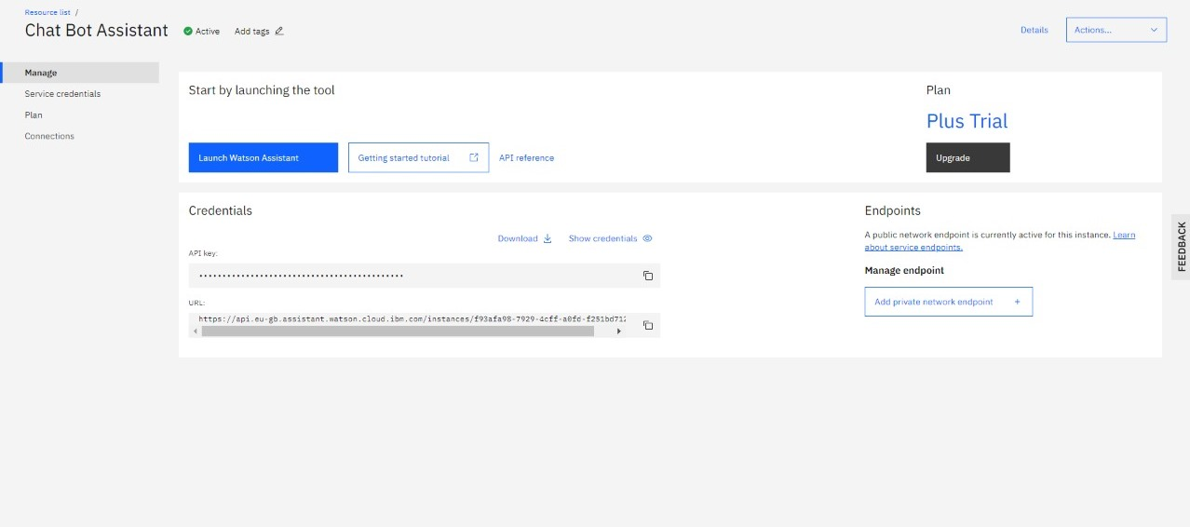

Slide 13
Deployment

Slide 14
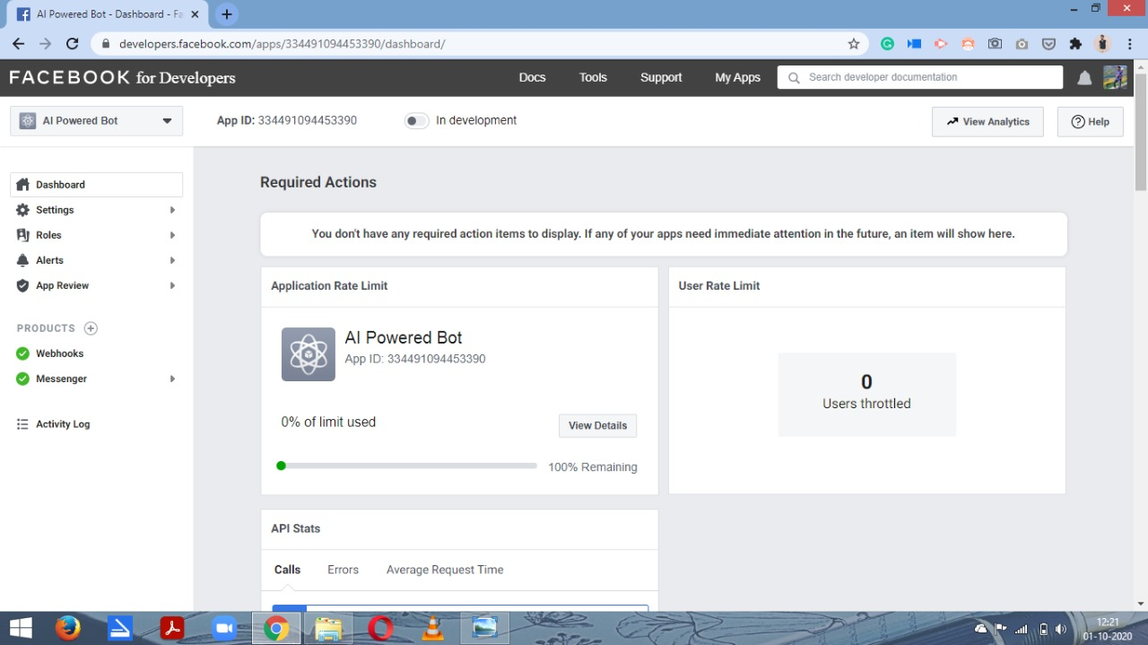
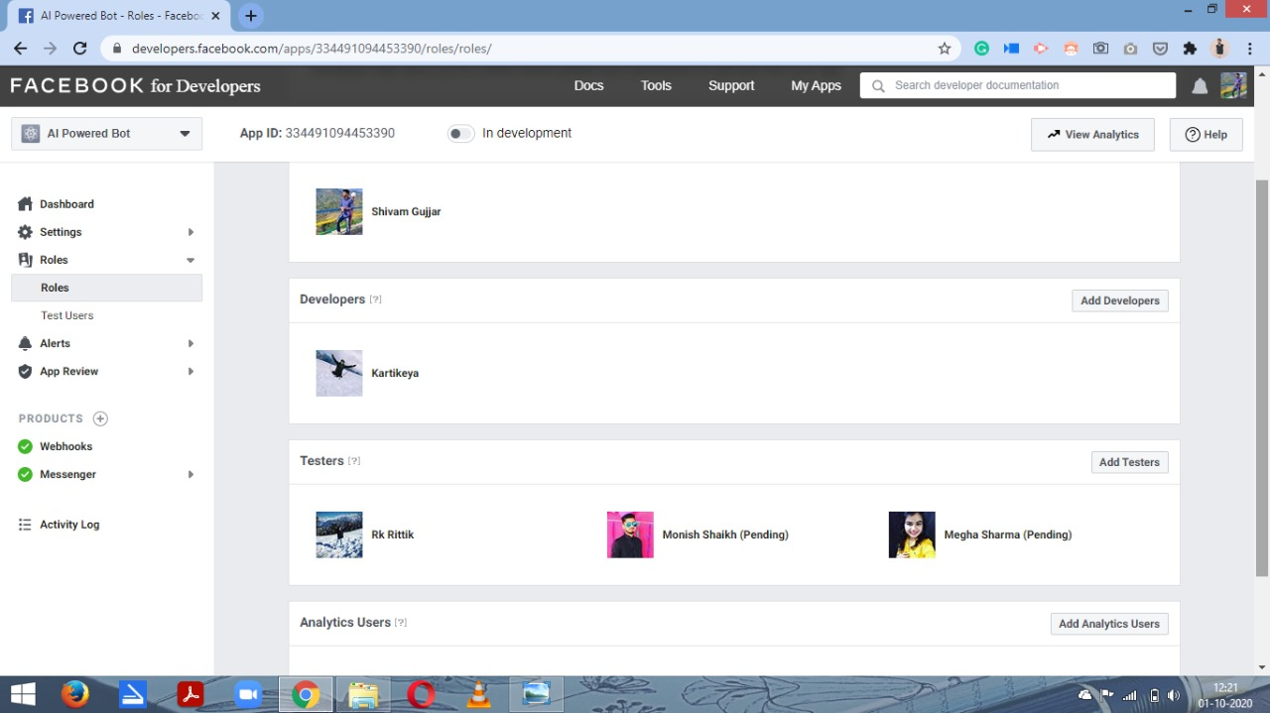

Slide 15
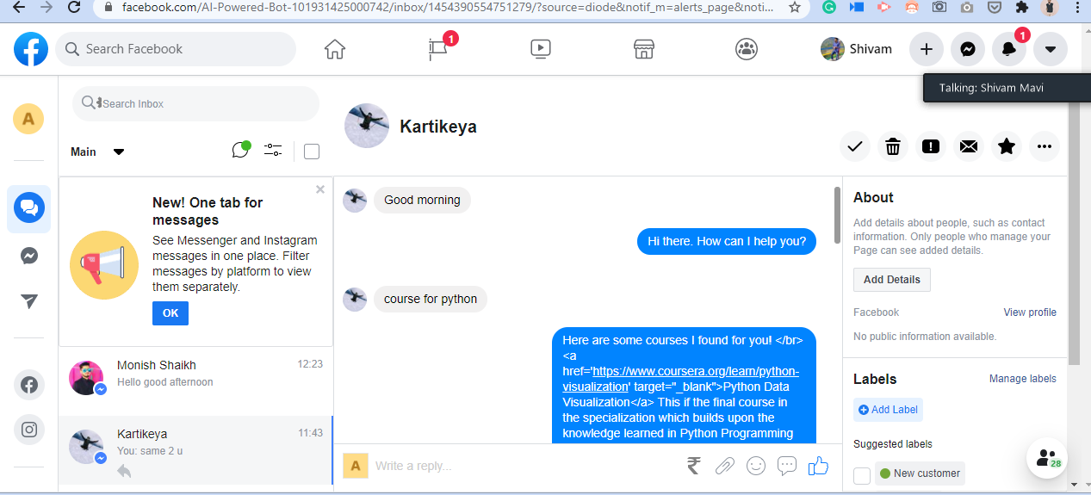

Slide 16
Thank You
©Kartikeya

